Slide 1
FDA304 Art References.
Task: Find 10 game references.

Slide 2
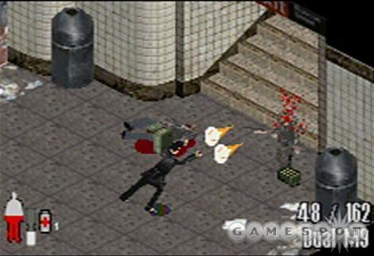
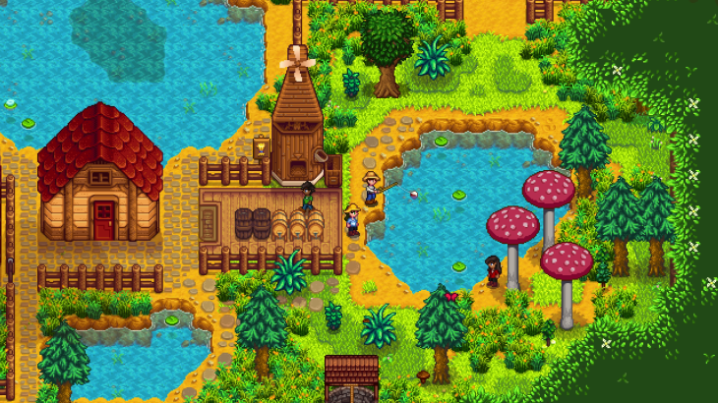
Reference 1: Max Payne (GBA)/Reference 2: Stardew Valley.

Slide 3
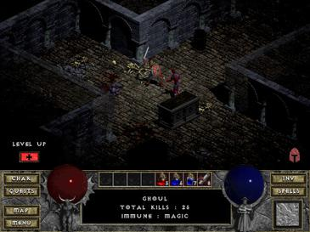
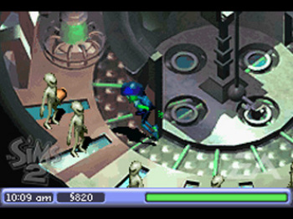
Reference 3: Diablo 1/Reference 4: The Sims 2 (GBA).

Slide 4
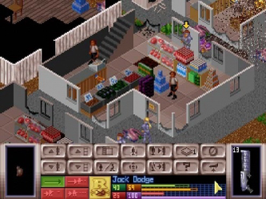

Reference 5: X-COM-UFO DEFENCE. Reference 6: マザースリー・Mother 3.

Slide 5
References.
Gerstmann, J. (2003) Max Payne Review. Available at: https://www.gamespot.com/reviews/max-payne-review/1900-6085966/.
Stardew Valley’s big update is now available for iOS and Android (2023). Available at: https://techcrunch.com/2023/01/09/stardew-valley-apps-ios-android-patch-1-5/?guccounter=1.
Wikipedia contributors (no date) File:Diabloscreen.jpg - Wikipedia. Available at: https://en.wikipedia.org/wiki/File:Diabloscreen.jpg.
The Sims 2 (no date). Available at: https://www.nintendo.co.uk/Games/Game-Boy-Advance/The-Sims-2-267508.html.
Wikipedia contributors (no date b) File:Xcom2.png - Wikipedia. Available at: https://en.wikipedia.org/wiki/File:Xcom2.png.
Nightingale, E. (2022) Mother 3 producer says he’d love to see an English localisation. Available at: https://www.eurogamer.net/mother-3-producer-says-hed-love-to-see-an-english-localisation.

